Slide 1


Java Database Connection (JDBC)
SDET Fundamental Training

Slide 2

JDBC API
JDBC 4.0 (part of JSE 6) is an API that provides standard for connectivity to variety of data sources like SQL databases, spreadsheets and flat.
JDBC provides call-level API for SQL databases meaning, API defines a set of interfaces and abstract methods. The database vendors (like Oracle, MySQL) must implement the JDBC API.
Therefore before writing JDBC code we must make sure that we have the library with respect to the data source that we intend to use.
JDBC is based on the X/Open SQL Call Level Interface (CLI). JDBC 4.0 complies with the SQL 2003 standard.

Slide 3
JDBC 4.0
java.sql JDBC Core API
javax.sql JDBC Optional Package API

Slide 4

Steps to Writing Database Code
Load the driver
Obtain connection
Create and execute statements
[Use result sets to navigate the results]
Close the connection

Slide 5
Load the driver
java.sql.DriverManager class is used to get drivers and get connection to the database. To register (Load) the driver with the application explicitly:
Class.forName(“<driver class name>");
or
DriverManager.registerDriver(new <driver class name>());
Both of these registers the given driver with the DriverManager.. Static block of the <Driver class> calls DriverManager.registerDriver() method

Slide 6
Get Connected
static Connection getConnection(String url) throws SQLException
static Connection getConnection(String url, Properties info) throws SQLException
static Connection getConnection(String url, String user, String password) throws SQLException

Slide 7
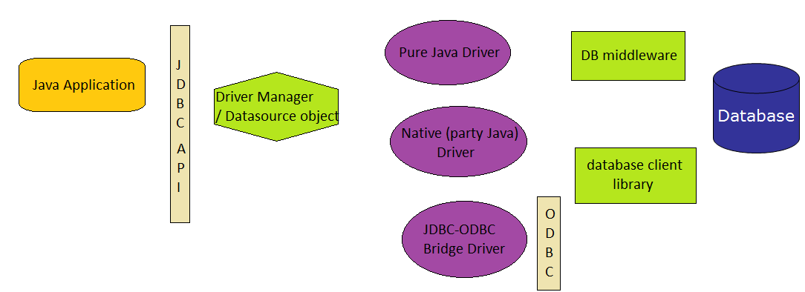
JDBC Architecture
4 ways to connect to database – through 4 types of driver

Slide 8
Driver Types
JDBC driver are classes used to translate JDBC calls either to vendor-specific database calls or may be directly invoke database commands.
Types of Drivers:
JDBC-ODBC Bridge, plus ODBC driver
Native-API, partly Java Driver
JDBC-net, pure Java Driver
Native-protocol, Pure Java Driver

Slide 9
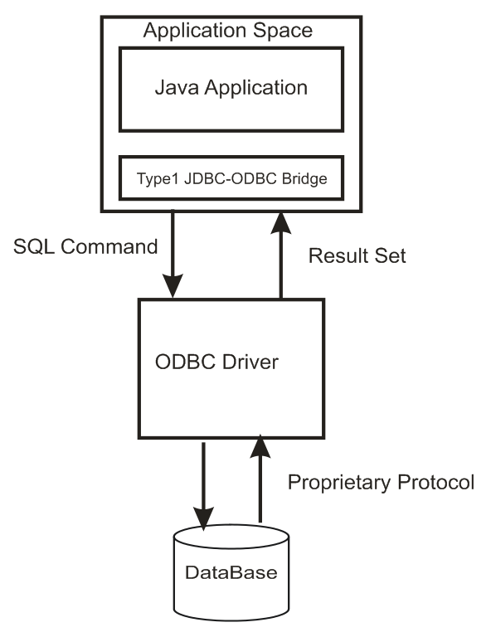
JDBC-ODBC Bridge, Plus ODBC Driver
This is the first type of Driver
Provided since JDK 1.1
Used for prototyping

Slide 10
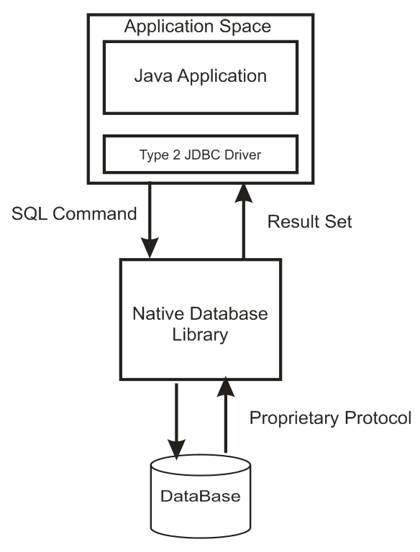
Native-API Partly Java Driver
Converts JDBC Commands into DBMS-specific calls
Advantage over JDBC-ODBC, since they interface directly with the database

Slide 11
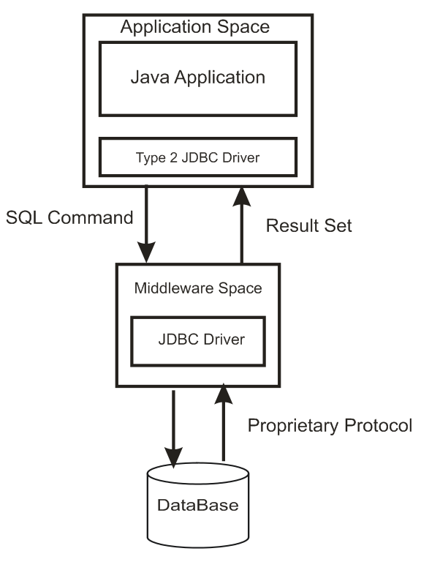
JDBC-net Pure Java Driver
Three tier solution
Translates JDBC calls into a DataBase independent protocol
The results are routed back from middleware to client
Pure java client
Swaps DataBase with affection client

Slide 12
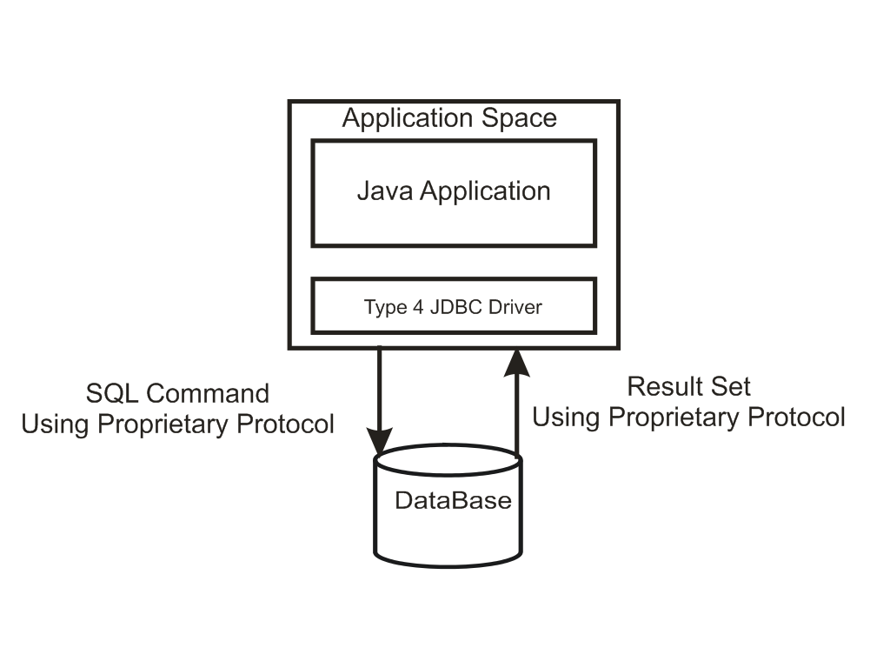
Native-protocol, Pure Java Driver
Pure java drivers
Direct communication with DB
No addition translation or middle layers
Improved performance

Slide 13
Code to get JDBC-ODBC connection
import java.sql.*;
public class ODBCMain{
Connection con;
public ODBCMain() {
try {
//sample is data source name (DSN)
String url = "jdbc:odbc:sample";
//Load the JDBC-ODBC bridge driver
Class.forName("sun.jdbc.odbc.JdbcOdbcDriver");
//Obtain the connection to the database
con = DriverManager.getConnection(url);
System.out.println (“JDBC-ODBC connection established");
con.close();
}
catch(Exception e){
e.printStackTrace();
} }
public static void main(String str[]){new ODBCMain();}}

Slide 14

Disadvantages
ODBC uses a C. Calls from Java to native C code have a number of drawbacks in the security, robustness, and automatic portability of applications.
Multiple layers of indirection leads to inefficiency.

Slide 15

Connecting Using Type 4 Driver
There are two ways in which we can write this code to connect to a database using Type 4 driver
By specifying class explicitly in the code using Class.forName() or DriverManager.registerDriver()
By using JDBC 4.0 way where we can avoid hard coding the class name in the code.
MySQL database using type 4 driver name is com.mysql.jdbc.Driver.

Slide 16
Connecting Using Type 4 Driver
But before we write code to connect to MySQL database:
we must have database. Create a database called test in MySQL.
set the classpath to the jar file with respect to MySQL in the classpath. Download Connector/J driver for mysql-connector-java-5.0.4-bin.jar.

Slide 17
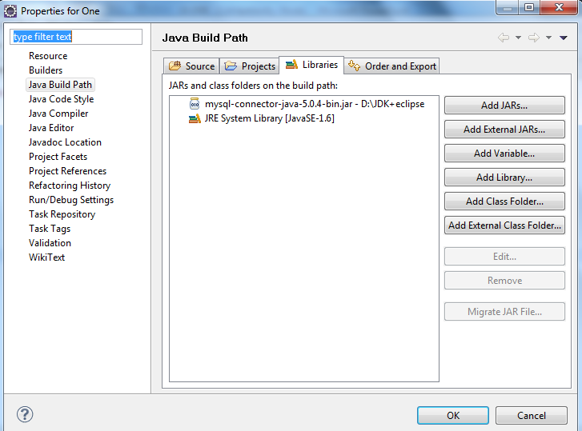
Setting classpath to MySQL driver in Eclipse
Select your project, Go to Project menu and select Properties.
Move to “Java Build Path” on the left panel. Click on “Add External JARs”, browse and locate the jar file for MySQL.
Click on Open. This will add the jar file to the Properties Box as shown in the diagram.

Slide 18
Example: Connecting to MySQL
import java.sql.*;
import java.util.Properties;
public class Connect {
public static void main (String[] args) {
Connection conn = null;
try {
String userName = "root";
String password = "root";
String url = "jdbc:mysql://localhost/test";
Class.forName ("com.mysql.jdbc.Driver");
Properties connectionProps = new Properties();
connectionProps.put("user", userName);
connectionProps.put("password",password);
conn = DriverManager.getConnection(url,connectionProps);
System.out.println ("Database connection successful");}

Slide 19
Example: Connecting to MySQL
catch (SQLException e){
System.err.println ("Failed to connect to database" +e);
}
finally{
if (conn != null) {
try { conn.close ();}
catch (SQLException e) { }
}
}
}
}
Result:
Database connection successful

Slide 20
java.sql.Connection
Connection is an interface.
getConnection() method of DriverManager returns the object that implements this interface.
Connection class can be used to do a variety of tasks
Obtain Statement object
To work with transactions
To get meta-data about the database
For executing a static SQL statement and returning the results it produces, an object that implements Statement interface is used.

Slide 21
Obtaining Statement
Connection class methods to obtain Statement and its subclasses:
Statement createStatement() throws SQLException
PreparedStatement prepareStatement(String sql) throws SQLException
CallableStatement prepareCall(String sql) throws SQLException
Statement
PreparedStatement
CallableStatement

Slide 22
SQLException
Most methods in the java.sql and javax.sql packages throw SQLException.
This object can be used to get message describing the error, SQL state, error code specific to the database and a reference to any chained exceptions
int getErrorCode()

Slide 23
Statement
The object of this type is used for executing a static SQL statement and returning the results it produces.
The result of the query statement is returned in the form of ResultSet object .
Only one ResultSet object per Statement object can be open at the same time.
Therefore, reading data 2 or more ResultSet objects would require obtaining ResultSets from different Statement objects.
On calling execute methods on Statement object, the ResultSet object obtained from this Statement object (if there are any) is automatically closed.

Slide 24
Statement members
ResultSet executeQuery(String sql) throws SQLException
sql is typically a static SQL SELECT statement. a ResultSet object that contains the data produced by the given query; never null
int executeUpdate(String sql) throws SQLException
sql is typically a SQL DML (INSERT, UPDATE, or DELETE statement) or DDL like (CREATE, DROP statements)
Returns the row count as number of rows affected for DML statements or 0 for SQL DDL statement.

Slide 25
Statement members
int executeUpdate(String sql, int autoGeneratedKeys) throws SQLException
Executes the Sql statement. If auto-generated keys has value Statement.RETURN_GENERATED_KEYS, then auto-generated keys produced by this object will be made available for retrieval.
Statement.NO_GENERATED_KEYS will not make the auto-generated keys available
Return value is same as the above method
ResultSet getGeneratedKeys() throws SQLException
Retrieves any auto-generated keys created as a result of executing this Statement object.

Slide 26
PreparedStatement
Interface that inherits from Statement
If the same sql statement is executed many times it is more efficient to use a prepared statement.
It enables a SQL statement to contain parameters like functions. So same statement can be executed for different set of values.

Slide 27
Using PreparedStatement for batch updates
Apart from the batch related methods added by the Statement interface, PreparedStatement adds one more
void addBatch() throws SQLException
is used to add batch of commands
But since most of the batch operations are executed using same sql statement, it is usually used with PreparedStatement since it allows parameterized statements and hence they can be cached to give better performance.

Slide 28
Example: Batch Updates
import java.sql.*;
public class BatchEx {
public static void main(String[] args) throws SQLException,
ClassNotFoundException {
Connection conn = null;
String userName = "root";
String password = "kanchan";
String url = "jdbc:mysql://localhost/navdb";
java.util.Calendar c = java.util.Calendar.getInstance();
Class.forName("com.mysql.jdbc.Driver");
conn = DriverManager.getConnection(url, userName, password);

Slide 29
Example: Batch Updates
// parameters are
// custName, amount, appliedDate, tenure, guarantor
PreparedStatement stmt = conn.prepareStatement("INSERT INTO mortgageloan (custname, amount, ”
+ "applieddate, tenure, guarantor) VALUES(?,?,?,?,?)");
stmt.setString(1, "Kumar");
stmt.setInt(2, 20000);
c.clear();
c.set(2015, 9, 25);
stmt.setDate(3, new java.sql.Date((c.getTime()).getTime()));
stmt.setInt(4, 120);
stmt.setString(5, "Kanchan");
stmt.addBatch();

Slide 30
Example: Batch Updates
stmt.setString(1, "Pete");
stmt.setInt(2, 30000);
c.clear();
c.set(2016, 1, 3);
stmt.setDate(3, new java.sql.Date((c.getTime()).getTime()));
stmt.setInt(4, 220);
stmt.setString(5, "Andy");
stmt.addBatch();
stmt.executeBatch();
conn.close();
System.out.println("Data Stored successfully... ");
}
}

Slide 31
CallableStatement
Interface that inherits from PreparedStatement that is used to execute stored-procedure.
In Connection.prepareCall(String s) is used to create a CallableStatement.
The string parameter is of the form
{[?=] call <procedure-name>[<arg1>,<arg2>, ...]}
The arguments IN parameter values are set using the set methods inherited from PreparedStatement.
All OUT parameters must be registered before a stored procedure is executed.
void registerOutParameter(int parameterIndex, int sqlType) throws SQLException
java.sql.Types has all the parameters that can be sent as sqlType. (Please refer to <docfolder>\docs\api\java\sql\Types.html)

Slide 32
Java Code to call the stored procedure
DELIMITER //
CREATE PROCEDURE GETLOANAMT(IN loanid INT,OUT amt INT)
BEGIN
SELECT amount INTO AMT FROM mortgageloan WHERE mid=loanid;
END;
//
DELIMITER ;

Slide 33
Java Code to call the stored procedure
package com.naveen.jdbc;
import java.sql.*;
public class CallSPMySQL {
public static void main(String[] args) {
String userName = "root";
String password = "kanchan";
String url = "jdbc:mysql://localhost/navdb";
Connection conn = null;
try {
Class.forName("com.mysql.jdbc.Driver");
onn = DriverManager.getConnection(url, userName, password);
CallableStatement c = conn.prepareCall("{call GETLOANAMT (?,?)}");

Slide 34
Java Code to call the stored procedure
Integer amt = null;
c.setInt(1, 1);
c.registerOutParameter(2, java.sql.Types.INTEGER);
c.executeUpdate();
amt = c.getInt(2);
System.out.println("Name retrieved: " + amt);
} catch (Exception e) {
System.err.println("Failed to connect to database" + e);
}
}
}

Slide 35
JDBC DataSource MySQL
Most of the times we are looking for loose coupling for connectivity so that we can switch databases easily, connection pooling.
JDBC DataSource is the preferred approach if you are looking for any of these features in your application.
It is the responsibility of different Database vendors to provide different kinds of implementation of DataSource interface.
Examples:
MySQL JDBC Driver provides basic implementation of DataSource interface with com.mysql.jdbc.jdbc2.optional.MysqlDataSource
Oracle database driver implements it with oracle.jdbc.pool.OracleDataSource class.

Slide 36
JDBC DataSource Features
Caching of PreparedStatement for faster processing
Connection timeout settings
Logging features
ResultSet maximum size threshold

Slide 37
JDBC DataSource Example
package com.naveen.jdbc;
import javax.sql.DataSource;
import com.mysql.jdbc.jdbc2.optional.MysqlDataSource;
public class MyDataSourceFactory {
public static DataSource getMySQLDataSource() {
MysqlDataSource mysqlDS = null;
mysqlDS = new MysqlDataSource();
mysqlDS.setURL("jdbc:mysql://localhost:3306/navdb");
mysqlDS.setUser("root");
mysqlDS.setPassword("kanchan");
return mysqlDS;
}
}

Slide 38
JDBC DataSource Example
package com.naveen.jdbc;
import java.sql.Connection;
import java.sql.ResultSet;
import java.sql.SQLException;
import java.sql.Statement;
import javax.sql.DataSource;
public class DataSourceTest {
public static void main(String[] args) {
testDataSource("mysql");
System.out.println("--------------");
testDataSource("oracle");
}
}

Slide 39
JDBC DataSource Example
private static void testDataSource(String dbType) {
DataSource ds = null;
if ("mysql".equals(dbType)) {
ds = MyDataSourceFactory.getMySQLDataSource();
} else {
System.out.println("invalid db type");
return;
}
Connection con = null;
Statement stmt = null;
ResultSet rs = null;
try {
con = ds.getConnection();
stmt = con.createStatement();
rs = stmt.executeQuery("select empid, name from Employee");
while (rs.next()) {
System.out.println("Employee ID=" + rs.getInt("empid")
+ ", Name=" + rs.getString("name"));
}
} catch (SQLException e) {
e.printStackTrace();
}}}

